Slide 1

Microsoft Service Adoption Specialist and MS-721 Collaboration Communications Systems Engineer (beta)
Change Management, Adoption, End User Tips and Tricks and Teams Collab Communications Systems Engineer (Beta) MS-721 exam

Slide 2



Microsoft
Service
Adoption
Dan Rey MCT/MVP M365 Apps & Services

Slide 3
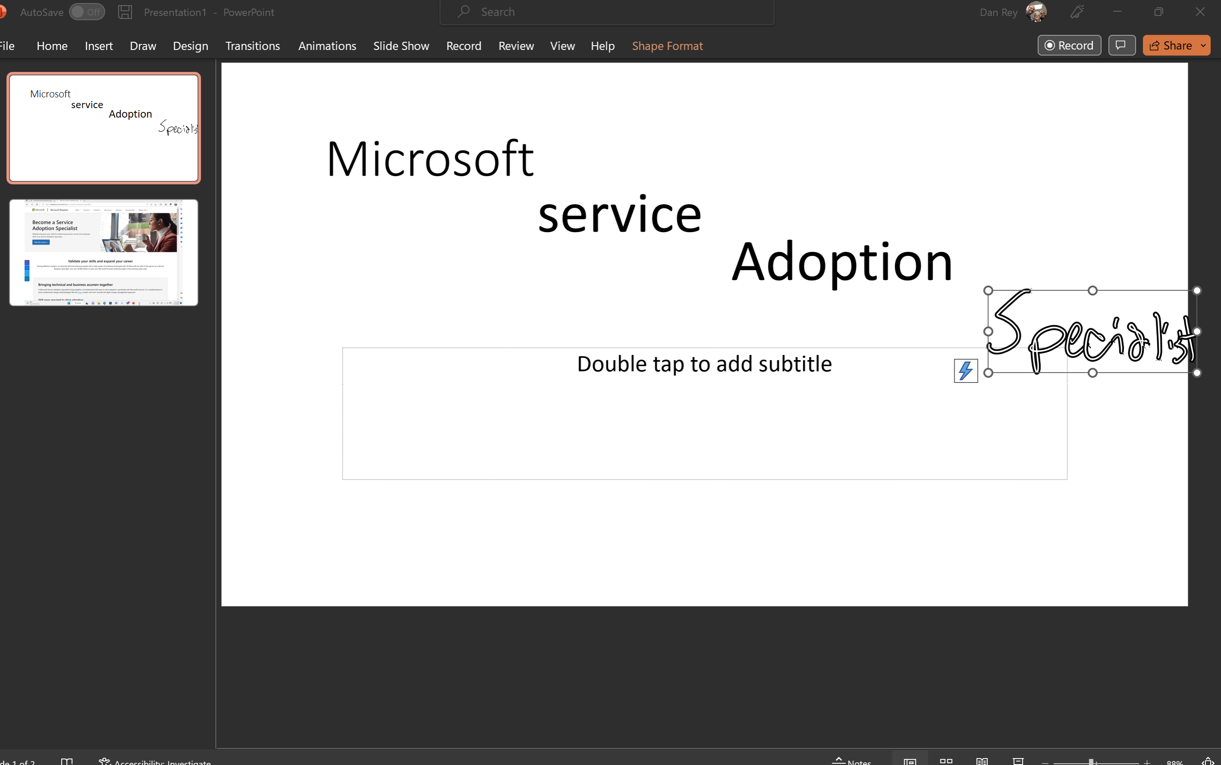

Slide 4
Microsoft Service Adoption Specialist
This is end user adoption / change management focused!

Slide 5
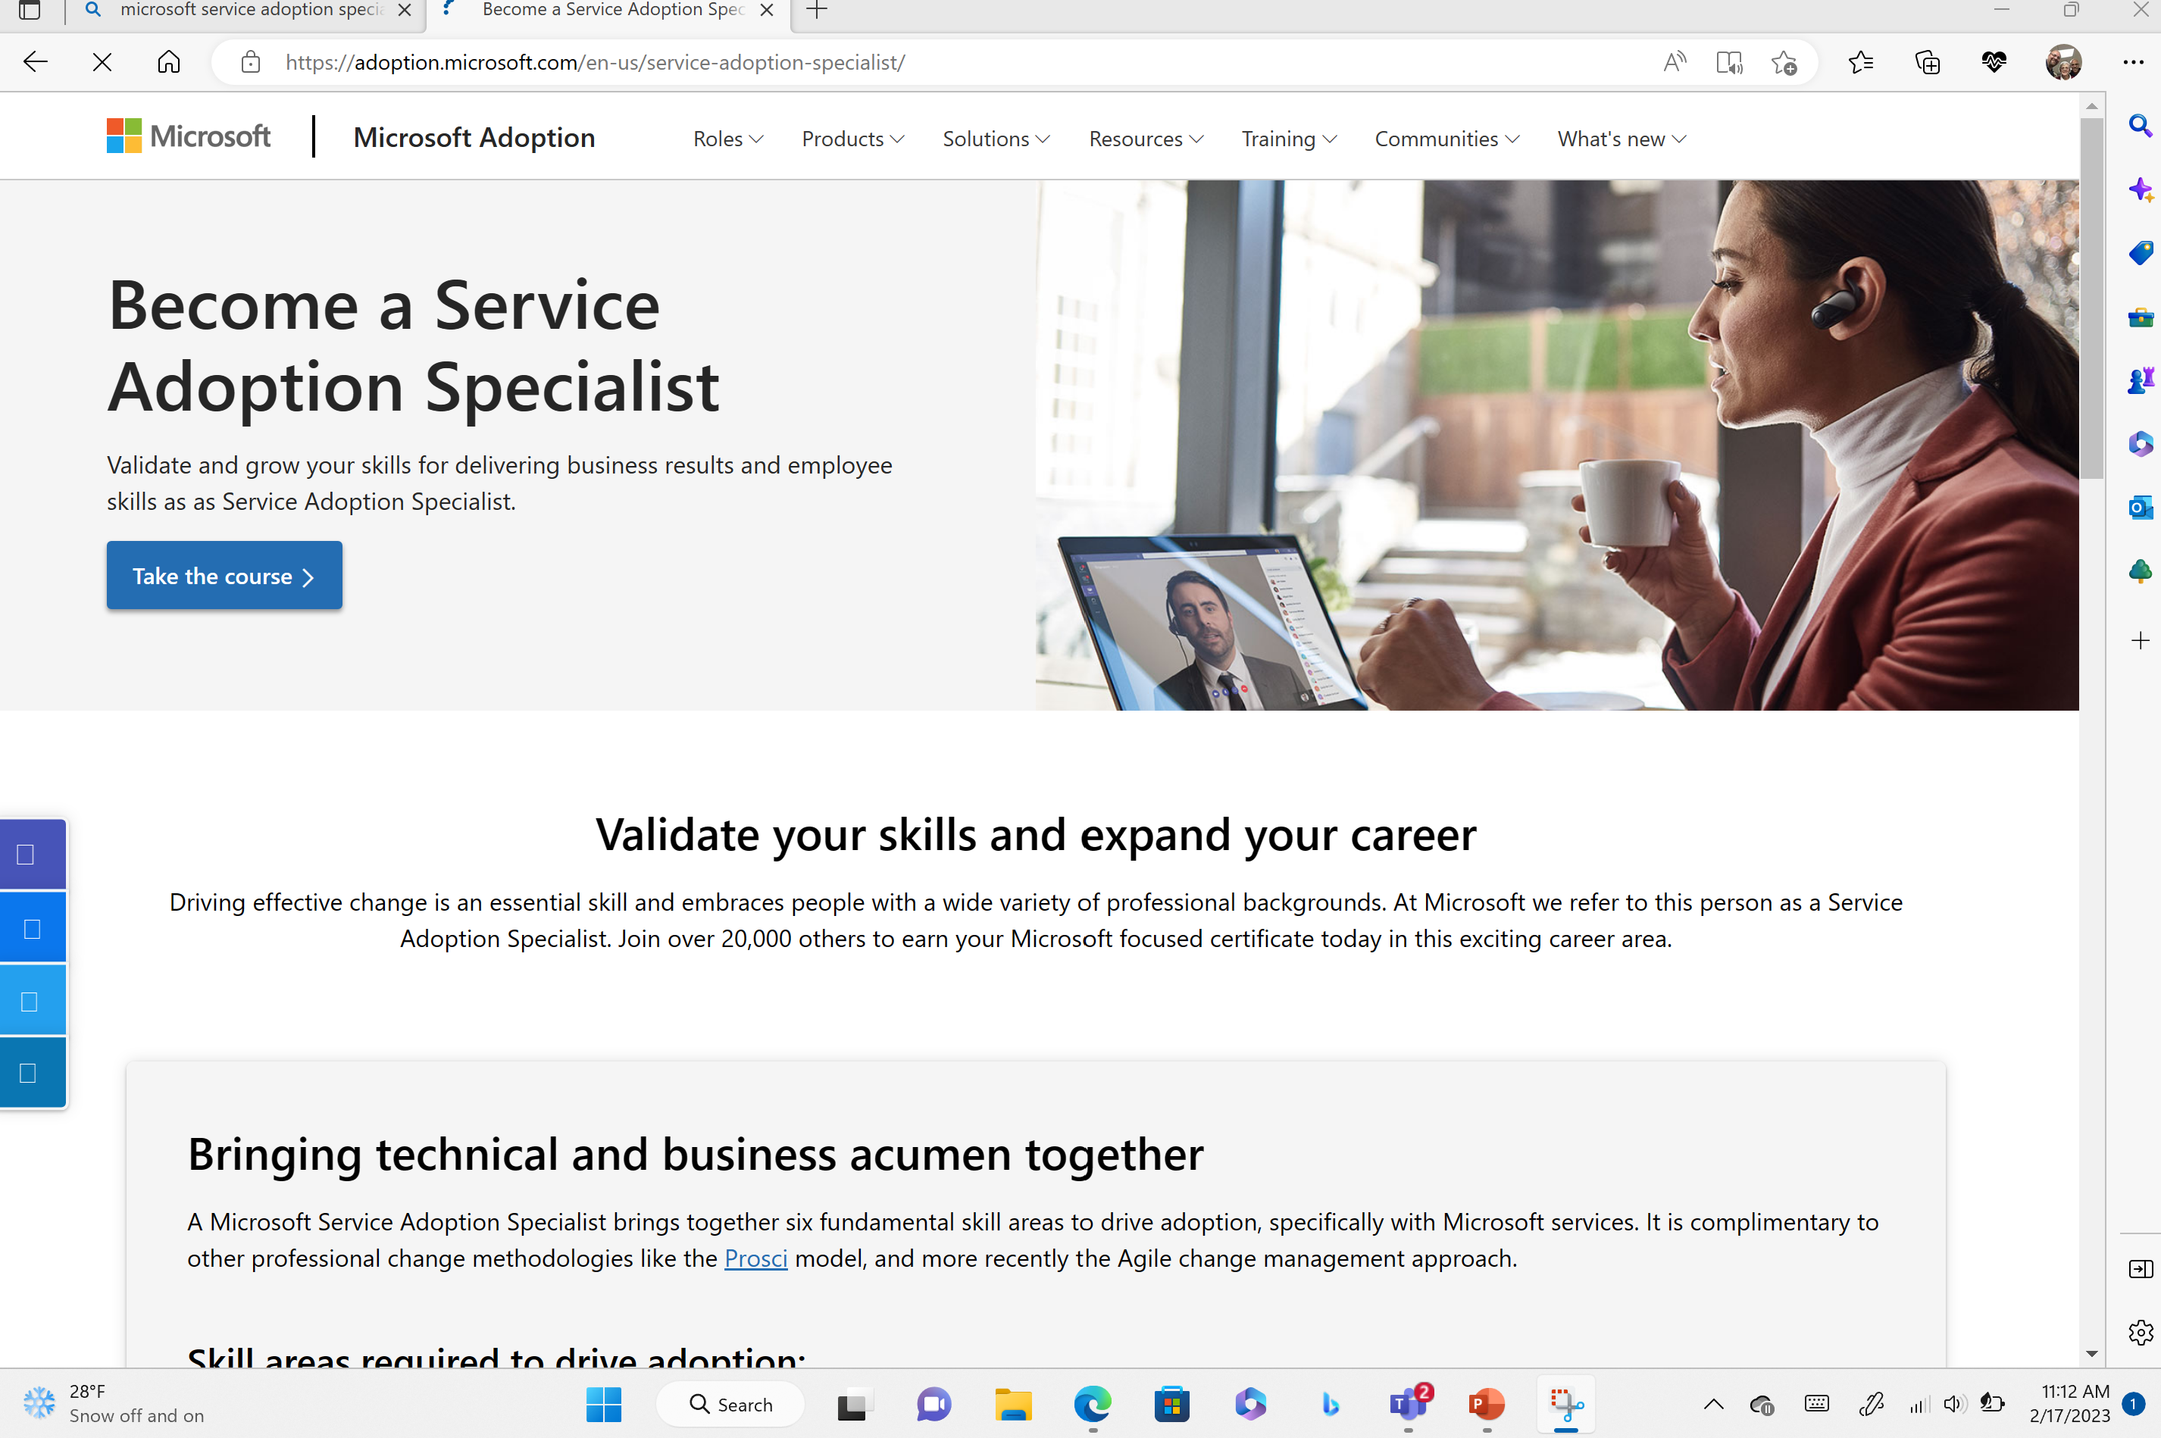

Slide 6
Microsoft Teams supports VERBAL and NONVERBAL Communication!
VERBAL communication includes:
Oral/Auditory
Written/Words
NON VERBAL communication includes:
Gestures
Reactions (facial expressions, body language, etc.)
Applause

Slide 7

Applause

Slide 8
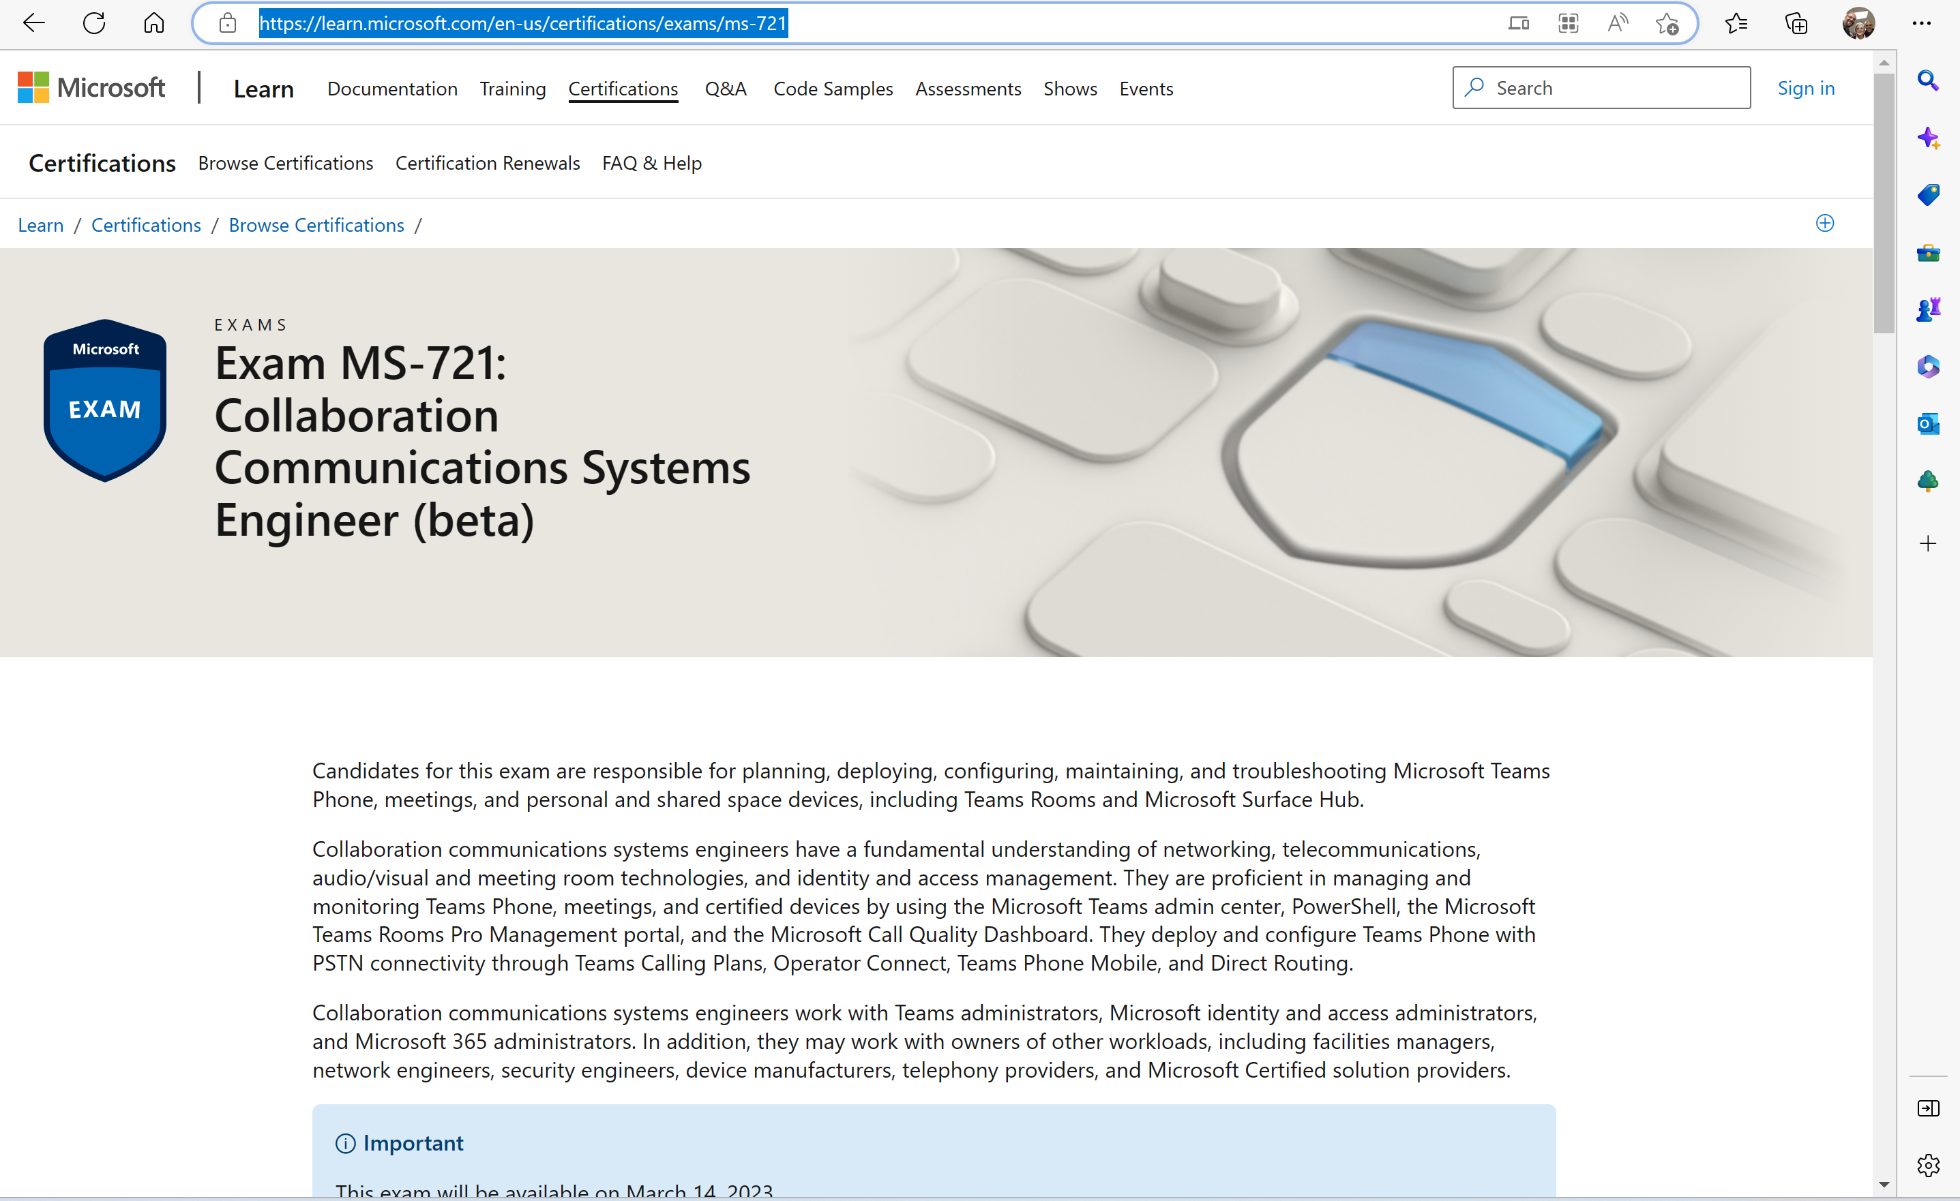

Slide 9
Skills Measured:
Plan and design collaboration communications systems (30–35%)
Configure and manage Teams meetings and events (10–15%)
Configure and manage Teams Phone (35–40%)
Configure and manage Teams Rooms and devices (15–20%)

Slide 10
Plan and design collaboration communications systems (30–35%)
Plan and Design Teams Meetings
Plan and design Teams meeting policies and settings
Plan for PSTN audio conferencing
Plan for Teams live events
Compare capabilities and features of Teams Core and Teams Premium
Recommend meeting types based on business requirements (virtual appointments, webinars, live events, and Teams meetings)
Design Teams policy packages (includes meeting policies, calling policies, and live events policies)
Recommend methods for assigning policies

Slide 11
Configure and manage Teams Phone (35–40%) high level objectives
Configure Teams Phone policies
Configure auto attendants and call queues
Configure dynamic emergency calling
Configure and manage users for Teams Phone
Configure and manage calling features for Teams Phone
Configure and manage Direct Routing for Teams Phone

Slide 12
Configure and manage Teams Rooms and devices (15–20%)
Maintain Teams Rooms and devices
Configure and manage Teams Rooms on a Surface Hub or Windows
Configure optional features for Teams Rooms and devices

Slide 13
Maintain Teams Rooms and devices
Configure device settings
Configure IP phone policies
Configure local network settings
Configure security and updates
Configure meeting room settings by using the Microsoft Teams admin center or the local Teams application settings
Create and configure device configuration profiles
Manage Teams Rooms from the Microsoft Teams Rooms Pro Management portal
Configure Intune policies for Teams devices
Enable advanced voice capabilities for shared space devices
Deploy common area phones
Create and manage Teams device tags
Deploy Android devices remotely
Configure SIP Gateway
Monitor Teams device health
Troubleshoot authentication issues
Troubleshoot update issues
Troubleshoot remote provisioning issues
Troubleshoot Bluetooth beaconing

Slide 14
Configure and manage Teams Rooms on a Surface Hub or Windows
Configure the authentication type during a Surface Hub out-of-box -experience (OOBE) setup
Configure meeting room settings on a Surface Hub device
Create and validate a Surface Hub provisioning package
Assign a provisioning package to a Surface Hub
Specify domain group policy exclusions for Teams Rooms on Windows
Configure custom displays for Teams Rooms on Windows
Customize meeting room settings by using XML files on Windows
Configure settings for peripherals for Teams Room on Windows

Slide 15
Configure optional features for Teams Rooms and devices
Configure HDMI ingest and options
Configure a content camera
Configure Teams casting
Auto accept a proximity join
Allow room remote
Configure an intelligent speaker
Configure Direct Guest Join
Configure hot desking on Teams shared devices

